Slide 1

GeoCool
A GeoAI decision-support system for prioritizing and designing urban cooling corridors.
Project Guide :- Dr. Sharwari Deshmukh
NAME | SECTION | ROLL NO
Ruchi Dadwani | A | 63
Janhavi Vaidya | A | 58
Rajat Kaware | A | 62

Slide 2
The Urban Heat Crisis
Tackling Nagpur's Green Deficit with Spatial Intelligence

Slide 3

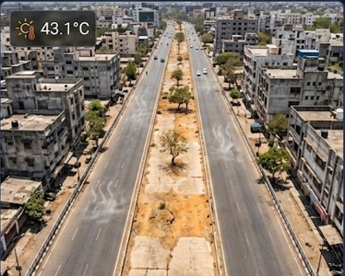
The Problem: Concrete & Heat
Urban Heat Islands: Dense concrete and asphalt roads trap extreme summer heat in cities like Nagpur, making streets hostile.
The Green Deficit: Rapid urbanization leaves little room for traditional large parks, demanding innovative linear solutions.
Neglected Edges: Crucial linear spaces—such as highway edges and urban road medians—remain barren and underutilized.

Slide 4






What We Are Building
Optimal Routing
Explainable AI
Context-Aware NBS
Automated graph-based routing to identify continuous corridors that balance thermal mitigation with physical construction feasibility.
Machine Learning combined with SHAP to generate natural-language justifications for why a specific route was selected.
Smart matching of Nature-Based Solutions (NBS) to specific urban typologies, shifting away from generic "plant a tree" mandates.

Slide 5


Feasibility vs. Need Engine
The Ecological Need
The Physical Feasibility
Focusing strictly on identifying the most vulnerable zones requiring immediate relief.
Ensuring the selected green infrastructure can actually survive in a semi-arid climate.
▪
Heat Index (LST): Severe surface temperature spikes.
▪
Space: Minimum viable street width (>3 meters).
▪
Elevation: Flat terrain (0-5% slope) for irrigation.
▪
Pollution (PM): High traffic particulate matter levels.
▪
Resources: Soil moisture and ground composition.
▪
Population: Dense areas for maximum socio-economic impact.

Slide 6

Multi-Source Geospatial Data
Data Layer | Measurement Objective | API / Dataset Source
Heat Index (LST) | Urban Heat Island locations | USGS Landsat 8/9 via GEE
Air Quality (PM) | Traffic & Industrial Pollution | WAQI Live REST API
Population Density | Citizen exposure impact | WorldPop via GEE API
Street Network | Road geometries & Widths | OSM Overpass API
Elevation & Soil | Plant survival constraints | SRTM DEM & ISRIC SoilGrids

Slide 7
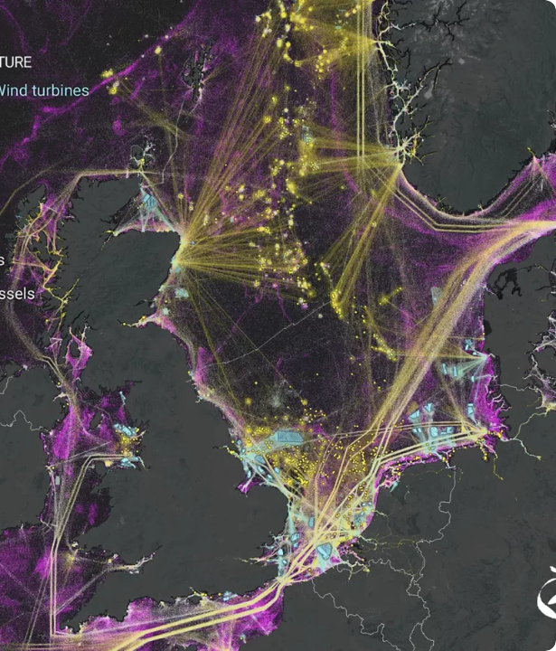
The AI Framework
Dual-Model Intelligence
1. AHP (Rule-Based Engine):
Our primary deterministic routing engine. Computes a Weighted Linear Combination over a NetworkX road graph for mathematically optimal paths.
2. ML & SHAP (Explainability):
Trains a Random Forest model on the same feature table to cross-validate rankings. Generates natural-language explanations like "Prioritized due to high LST."

Slide 8
Typology & NBS Matching
Moving Beyond Generic Planting
4
Instead of a simplistic "plant a tree" command, the system evaluates winning routes across four dimensions to assign highly specific Nature-Based Solution (NBS) packages.
1. Width: Determines canopy vs. vertical wall limits.
2. Accessibility: Distinguishes public vs. restricted zones.
Assessment Dimensions
3. NDVI: Maps baseline existing vegetation.
4. Context: Differentiates Residential vs. Industrial needs.

Slide 9


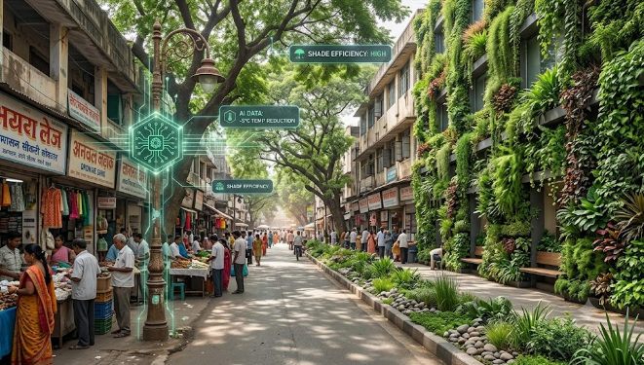
Adaptive Routing: Nagpur’s Urban Core
The Urban Challenge: The inner city is characterized by severe localized heat islands, high population density, and severely constrained street widths.
AI Data Evaluation: The algorithm prioritizes pedestrian cooling and socio-economic impact over pure ecological buffering.
Actionable Prescriptions: When routing through dense areas—such as commercial hubs or campus zones—the AI detects space limits and assigns space-efficient NBS like Vertical Green Walls, Bioswales, and Shading Canopy Trees.

Slide 10
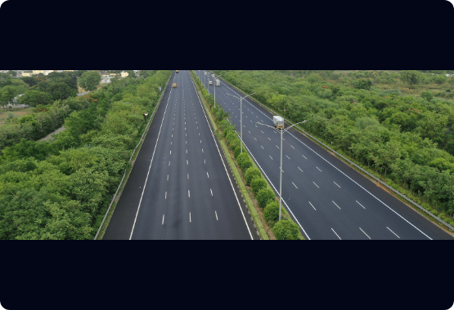
Adaptive Routing: The Samruddhi Transition
The Highway Challenge: As the route approaches arterial links like the Samruddhi Mahamarg, conditions shift to extreme heat reflection, dropping pedestrian density, and heavy PM emissions.
AI Data Evaluation: The engine detects wider road edges and automatically de-prioritizes population density, switching focus to heavy ecological buffering and drought-survival.
Actionable Prescriptions: The system halts pedestrian-focused infrastructure and deploys Phytoremediation Tree Belts using deep-rooted, drought-resilient native Indian species (e.g., Neem, Karanj).

Slide 11



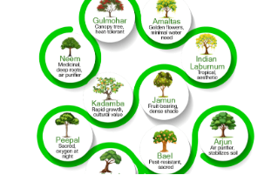
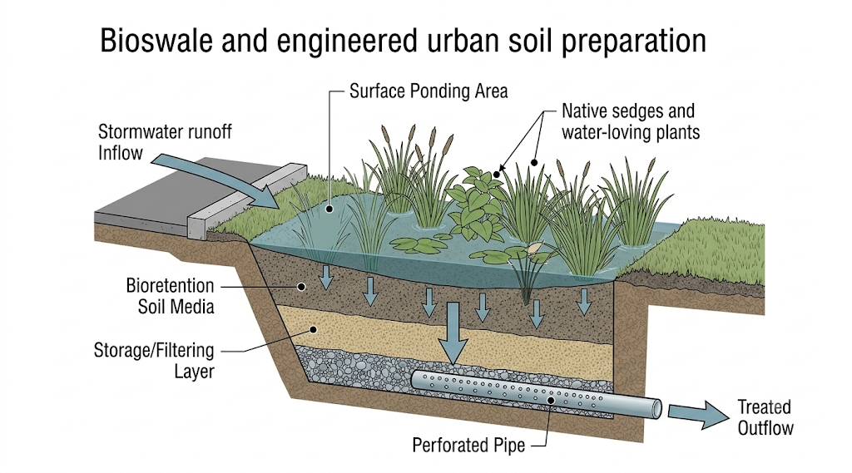
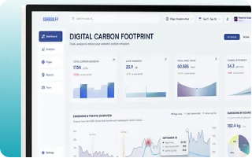
Actionable System Outputs
Botanical Specs: Native, drought-resilient species matched to local soil databases.
Context-Aware NBS: Specialized packages like bioswales or vertical green walls.
Carbon Dashboard: Net-zero crossover tracking and financial budget estimation.

Slide 12
Project Build Order
2. AI Routing
4. Full-Stack
AHP suitability scoring and NetworkX shortest-path execution.
Spring Boot API integration with the interactive React 3D map.
1. Base Data
3. ML & XAI
OSM road networks & Satellite layer ingestion via GEE API.
Validation via Random Forest and SHAP text generation.

Slide 13
Evaluation Strategy
Route Comparison: Quantifying the direct trade-off between the absolute shortest path and the AI-optimized ecological route.
Sensitivity Analysis: Systematically varying the top AHP matrix weights to measure stability and identify "low-regret" zones.
Multi-Scenario Testing: Cross-referencing outcomes from an Ecology-First scenario versus a Budget-First socio-economic scenario.
AHP vs. ML Agreement: Verifying if the trained Random Forest model's predictions align with the deterministic rule-based scoring.

Slide 14
References
Highway edge spaces as urban green infrastructure corridors: A typology-based NBS suitability framework for rapidly urbanising cities in the Global South. (https://doi.org/10.1016/j.tfp.2026.101395)
GIS-based prioritization of urban green roofs to enhance biodiversity in Amman, Jordan. (https://doi.org/10.1016/j.cacint.2026.100423)
Evaluating urban policy: A GIS-based comparison of urban green space suitability model with Adama City’s Structural Plan. (https://doi.org/10.1016/j.cacint.2026.100335)
Urban ecological corridors (UECs) as sustainable paths to climate change adaptation and urban resilience: Reflections from Kolkata, India. (https://doi.org/10.1016/j.las.2026.100049)

Slide 15
Thank You

